Slide 1

Zoom
Overview
Training
Herriman Rose Canyon Stake

Slide 2
Quick Links
Stake Website
  http://rc-stake.com/wpsite/zoom-meetings/
Hosting a Zoom and Presenting
    https://docs.google.com/document/d/1GEMrJ2wdIsl87dJqUbHCYoPm3dCr6ZD9d7xZnnpj--4/edit
Joining a Zoom from Your Browser
  https://docs.google.com/document/d/1dgANInQWo6COFZfVIZ8xrtyRMD4Y5hrMTMLEMgoLpoM/edit#heading=h.c8byfnlo9nse
Zoom Help and Support Tutorials
  https://support.zoom.us/hc/en-us/articles/206618765-Zoom-Video-Tutorials?_ga=2.54532651.1018616325.1601140511-1227989249.1601140511

Slide 3
BEST PRACTICES
Participants will be put in a waiting room and not automatically put in the meeting. The Host will need to accept people into the meeting
It is not a good idea for host or participants to be in the same room if they are using multiple devices
Learn how to “Mute All” and let them know they need to unmute if they want to say something
Ask Participants to share video- It is difficult to have discussions looking at blank screens
Try to avoid asking if people can hear you. It is better to ask if participants can use emoticons like the “Raised Hand”
Give people time to answer, they may need to unmute their mic and that might take a second or two
Know what your camera is always doing
When leading a discussion use a laptop and not a phone if possible
Use the whiteboard option to discuss lesson ideas
Keep people engaged while waiting for everyone to join- ask questions like- Who’s still in their Pajamas pants right now? Anyone reading anything interesting? Who has learned any new hobbies since this started? Etc…
When Ending the Meeting always remember to “End Meeting for All”

Slide 4
Key Board shortcuts
I is for invite. Press Cmd+I (macOS) or Alt+I (Windows) to jump to the Invite window, where you can grab the link to the meeting or send invitations to others via email.
M is for mute. Press Cmd+Ctrl+M (macOS) or Alt+M (Windows) when you are the meeting host and want to mute everyone else on the line.
S is for share. Press Cmd+Shift+S (macOS) or Alt+Shift+S (Windows) to share your screen or stop sharing.
Command + U: Display/hide participants panel (Mac) or Alt + U (Winows)
F is for Full. Press Command + Shift + F: Enter or exit full-screen(Mac) or Alt + F (Windows)
Y is for …Yell? Press Option + Y: Raise hand/lower hand (Mac)or Alt+Y (Windows)

Slide 5
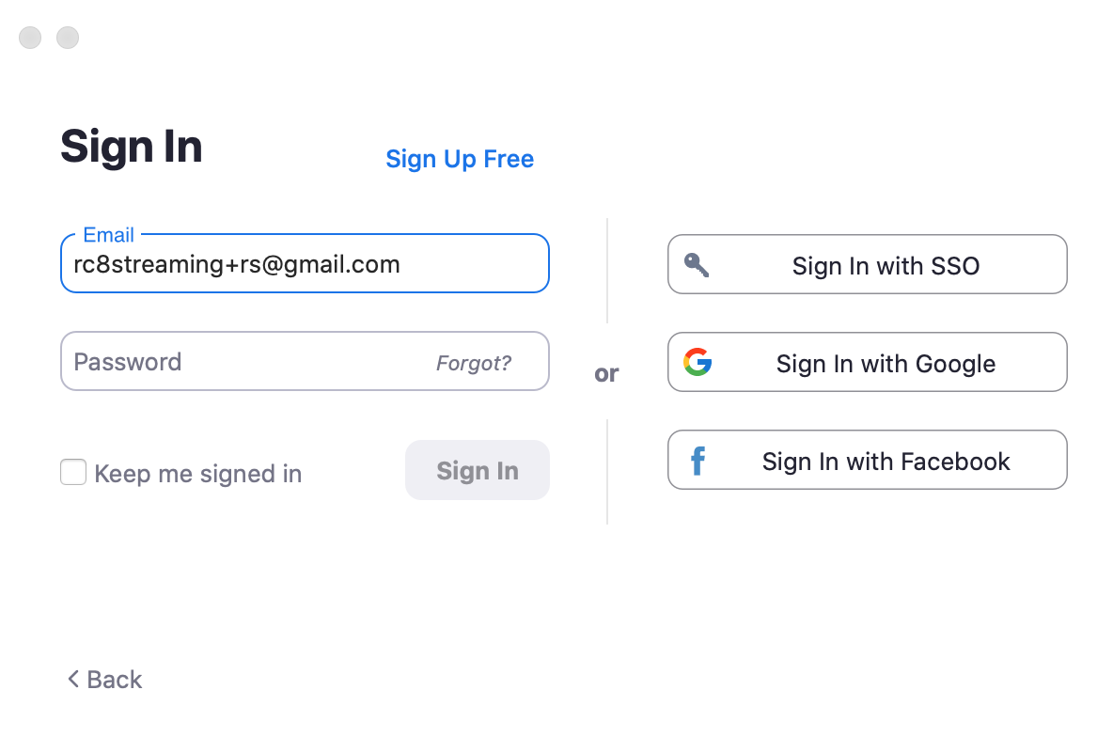


Signing in as the host
Use the credentials provided by the Bishop for your meeting
Do not login using Google, Facebook, or SSO link
Do not share password or login to anyone but your leaders or people assigned to have them
You can always start the meeting and make someone else the host
Your participants will use the meeting link to join the zoom for the example above they would use- https://us04web.zoom.us/j/4980889889?pwd=RjNodXlJZ2ttRkhiYTRHRy9rMzNFdz09
Join Using Computer Audio and Video

Slide 6
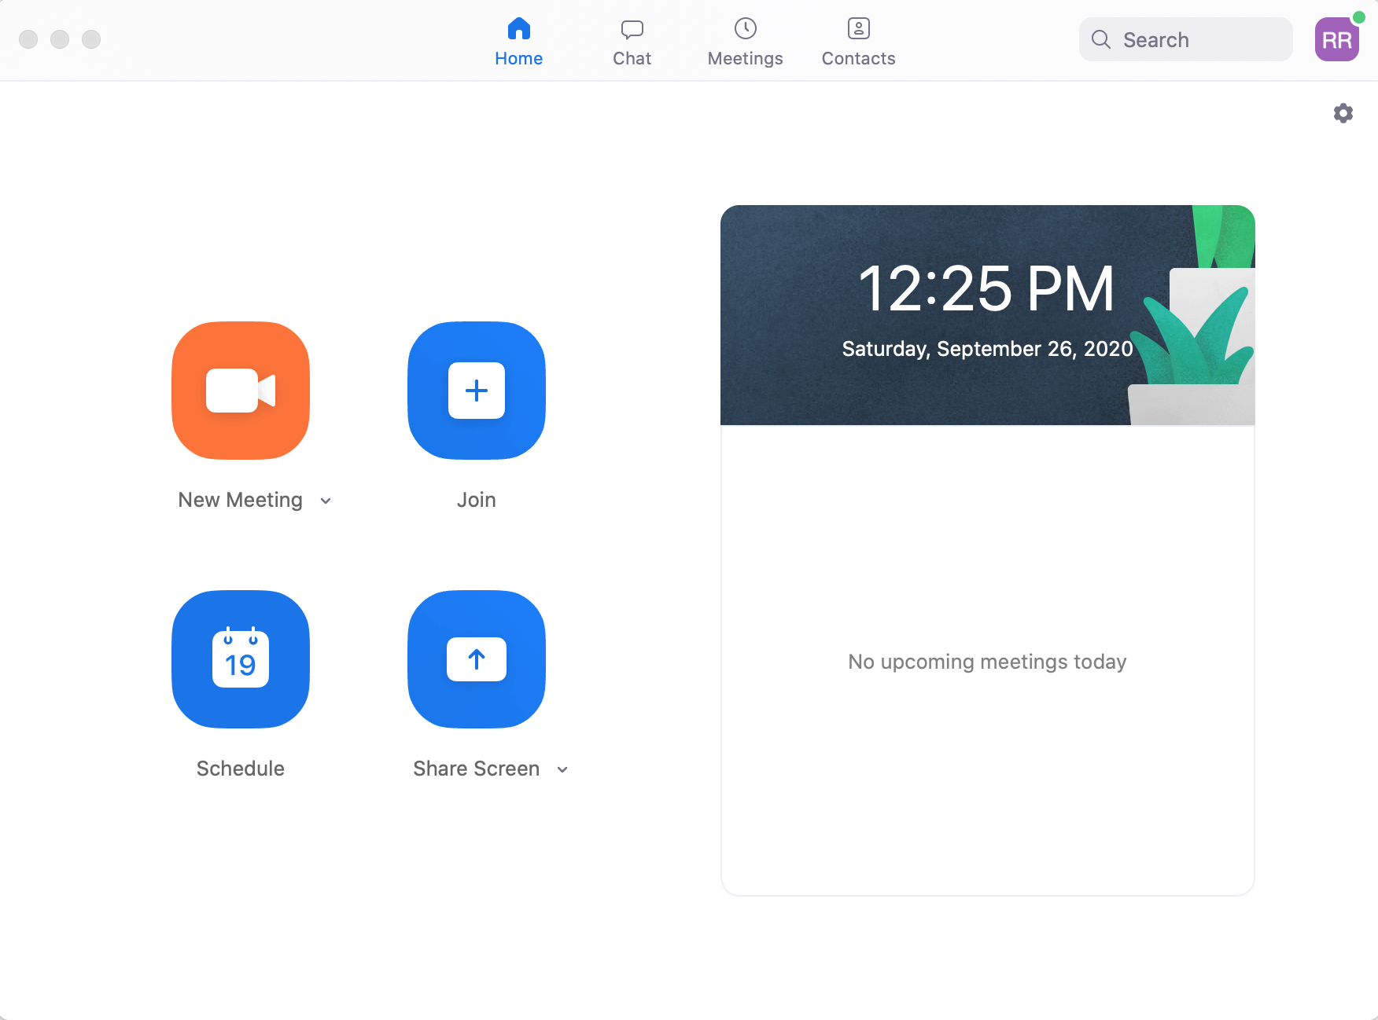
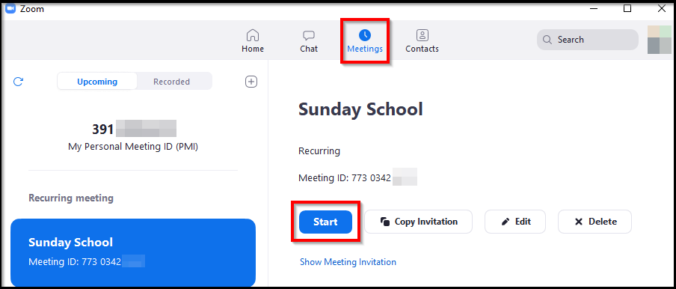
Signing in as the host Part 2
Windows-
Click on Meetings on the top of your screen (these meetings have already been setup)
Click on Start Meeting
Do not Click “New Meeting”

Slide 7
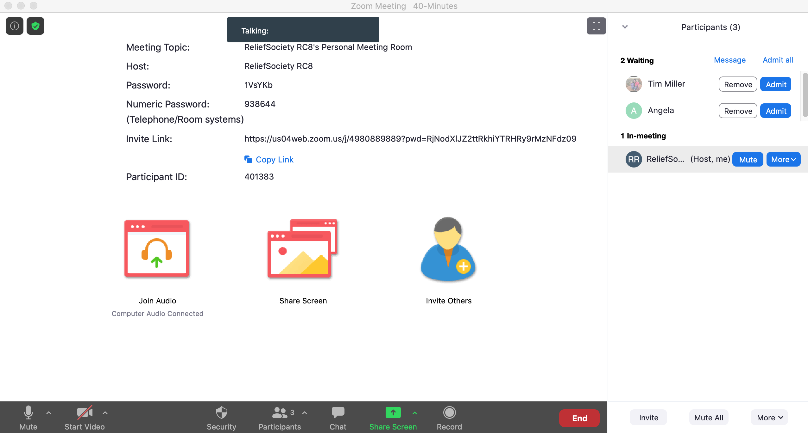
The Waiting Room
Under Menu Options “Window” (At the top of screen for Mac) Select “Always Show Meeting Controls”
Keep on Eye on the Participant Numbers
Click on Participants to see who is in the meeting
I like to keep this open at all times
Admit people to the meeting
Continue to monitor participants to admit late arrivals
Please be aware that these meetings are not password protected so make sure you are aware of who is joining and be ready to mute them or remove them

Slide 8
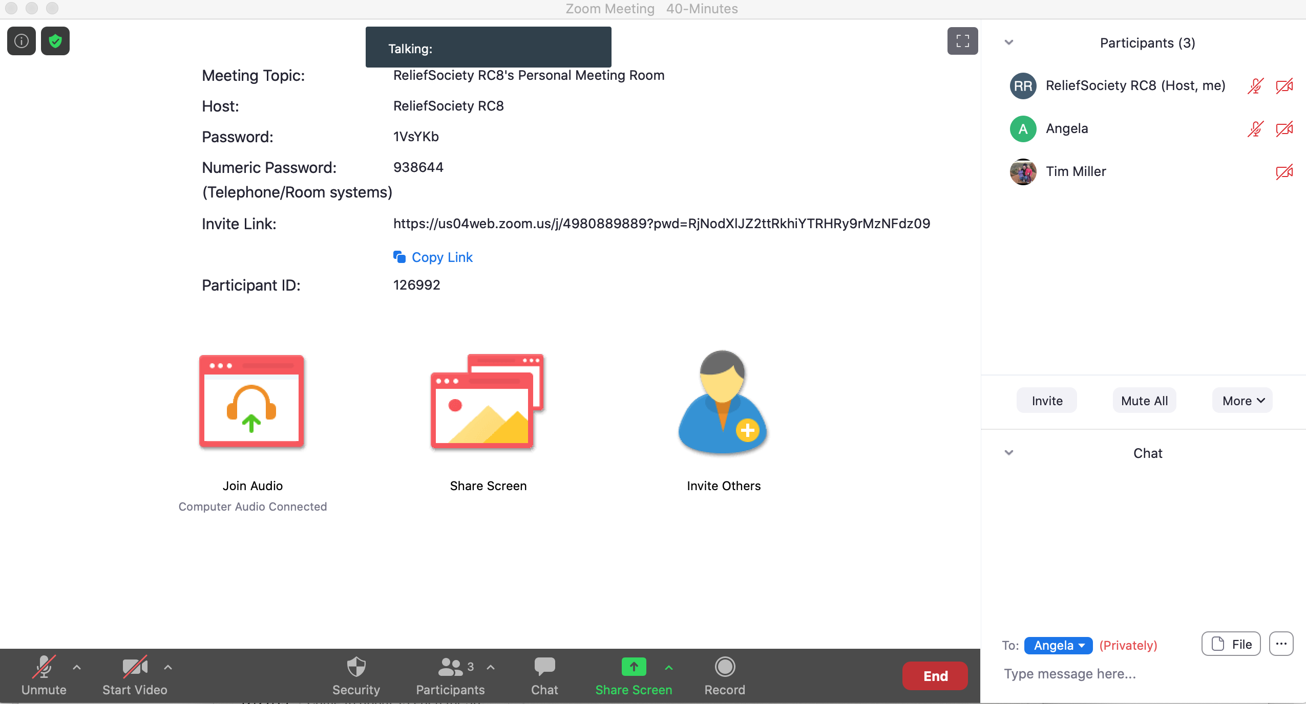

You can Mute or disable video of a Participant, but you can not unmute or turn on a camera
You can Mute all Participants, but you can not unmute a participant

Slide 9
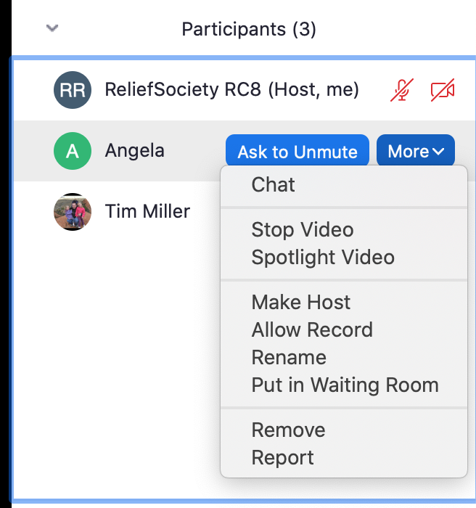

Switching the Host
Hover over a person’s name
Click “More”
Select “Make Host”
Once someone is the Host they will be in control of the Waiting room and host controls. They will also be able to make someone else the Host or make you the Host again

Slide 10
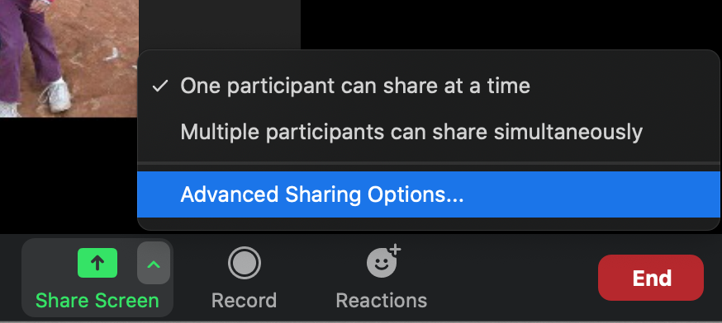
Allow others to Share while you are the Host
Click the little arrow at the bottom of the screen in the “Share Screen” Icon
Click “Multiple Participants can share simultaneously”
This option will let you share even when you are not the host
Pro Tip- Make someone else the host to monitor the waiting room and mute rowdy people. Then have them give you the ability to share

Slide 11
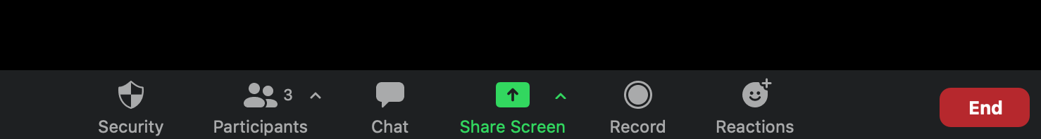
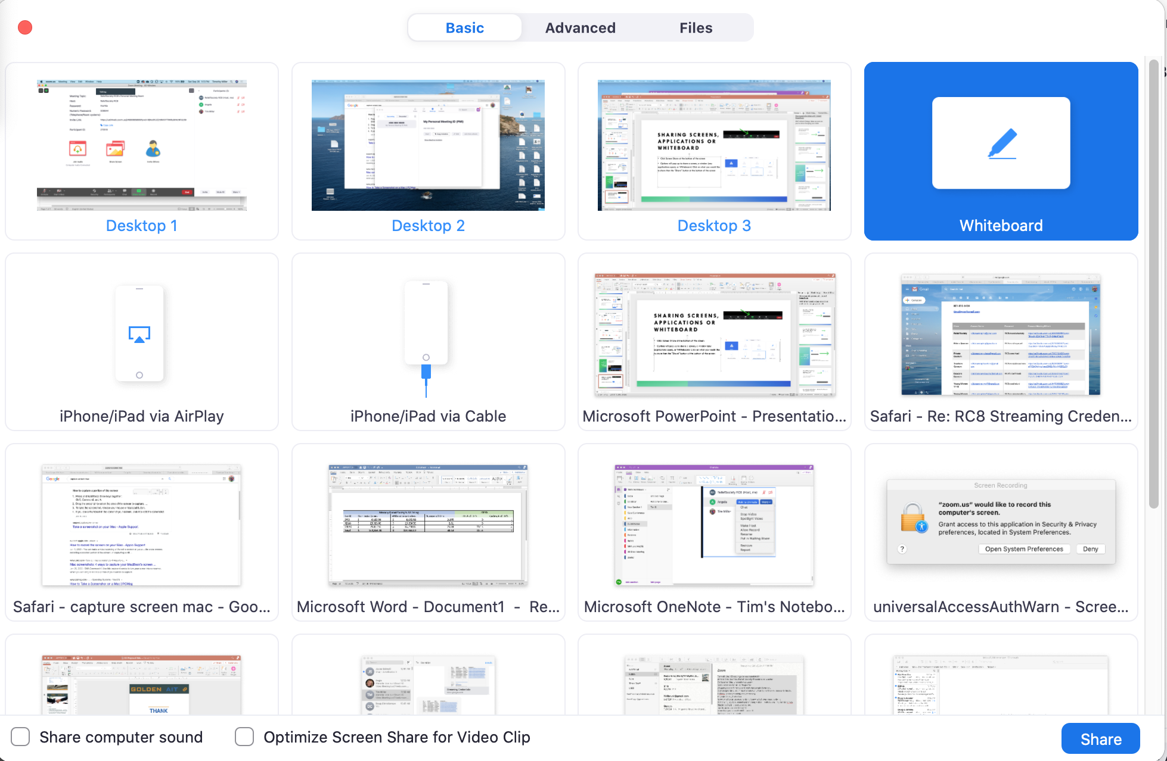
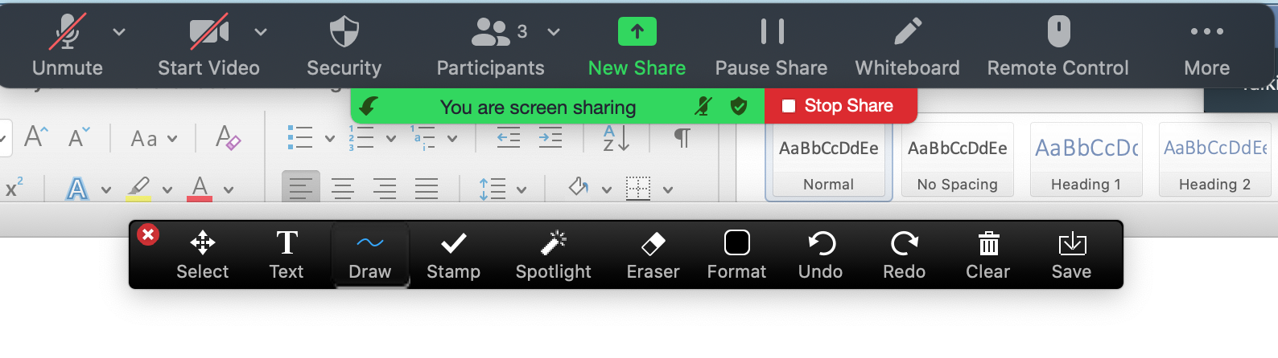
Sharing Screens, Applications or Whiteboard
Click Screen Share at the bottom of the screen
Options will pop up to share a screen, a window (any applications open), or Whiteboard. Click on what you would like to share then the “Share” button at the bottom of the screen
To Stop Sharing Click the ”Stop Sharing” button at the top of the screen

Slide 12
Sharing Tips
Sharing videos from your computer doesn’t always work well. You can try it but be prepared to stop it if people are having trouble viewing it.
  To Share a video you will also need to click the two options shown below (some computers only have one option)
Some people have downloaded the video to their Phone and then played the video on their phone to the camera on their computer. I am not sure how well that works but know people have done that before

Slide 13
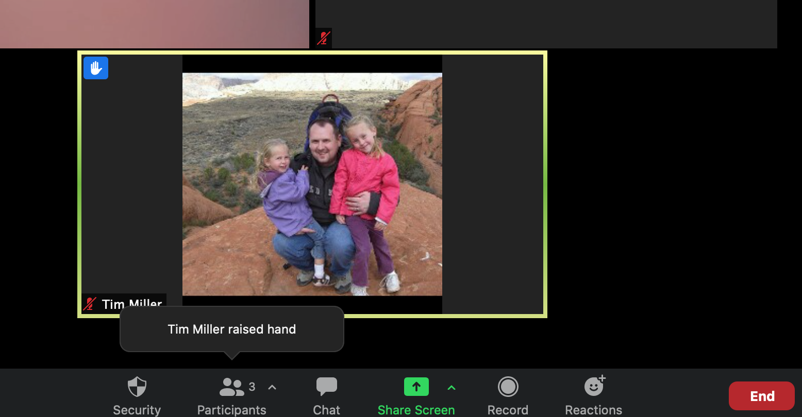
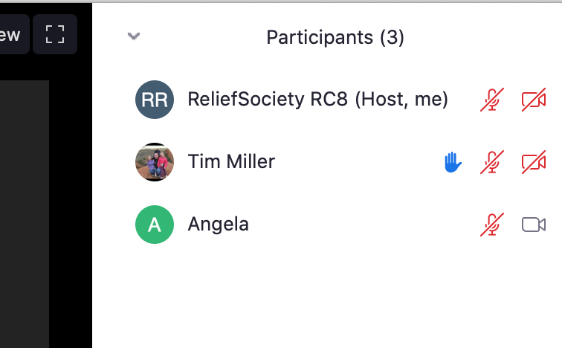
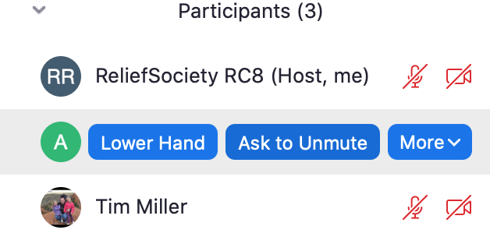
Raising Hands
Participants can use an emoji to raise their hand. If the class is large this might be the “Best Practice” for making a comment so everybody isn’t speaking over everyone else.
It is important to watch for the Raised Hand Notifications
If you do not have a Participant list open it will show at the bottom of the screen or in their video window
If you do have a participant list open it will show a hand next to there name
All participants can see if someone has a hand raised
You can manually lower a person's hand after you have responded by clicking on the blue hand icons

Slide 14
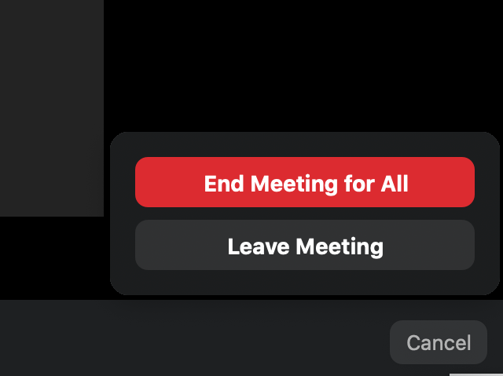
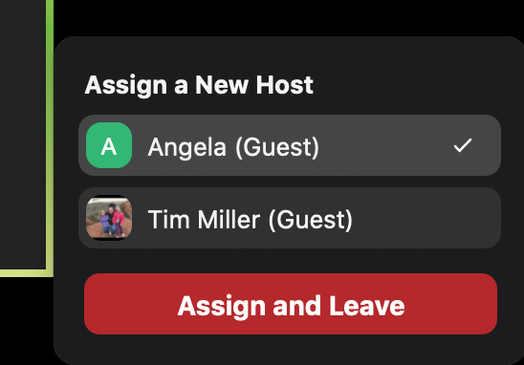
Remember to ”End Meeting for All” this will close the meeting for everyone
To End Meeting Click “End” in the bottom right
If you need to leave but need to keep the meeting open
Assign it to another person and they will become the host

